Slide 1
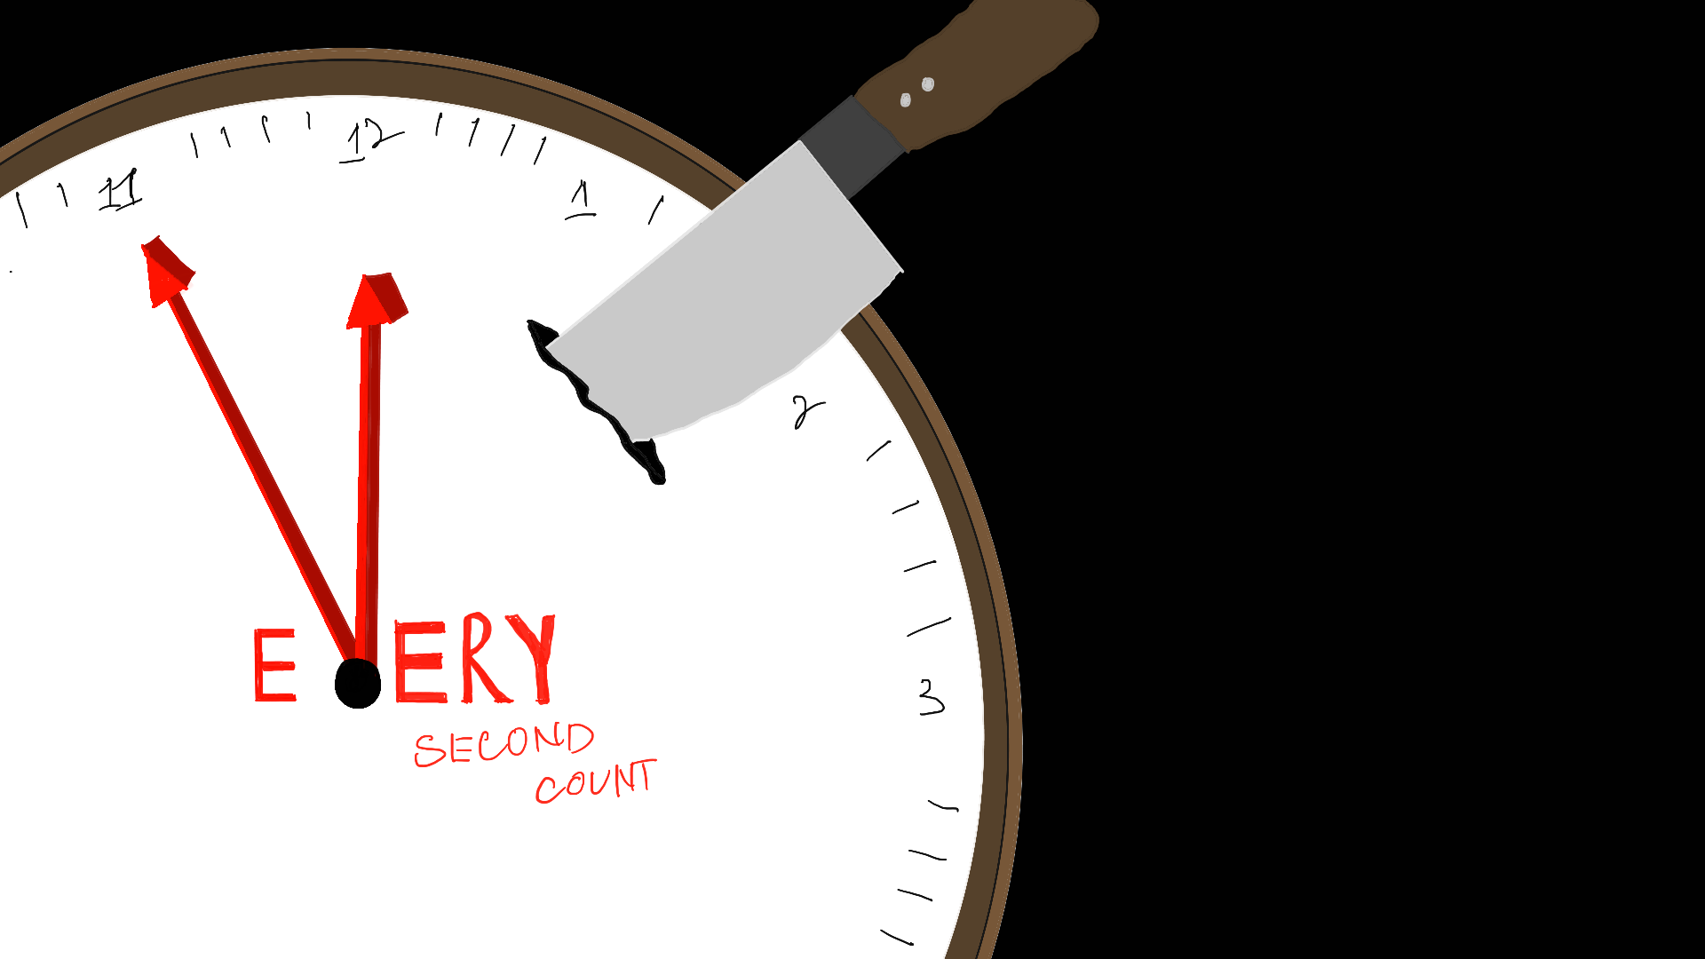
WIU PRESENTATION
By: MINH QUAN, HAZWAN, CHERRY, JUN HAO, ERIC (GROUP 14)

Slide 2
Vision:
FA single-player 2D interactive text - based game in which the protagonist is stuck in a time loop with the goal of escaping death by a killer within a 8 minutes time frame where every decision can lead to a different ending.

Slide 3

Trailer:

Slide 4

Ideation process

Slide 5
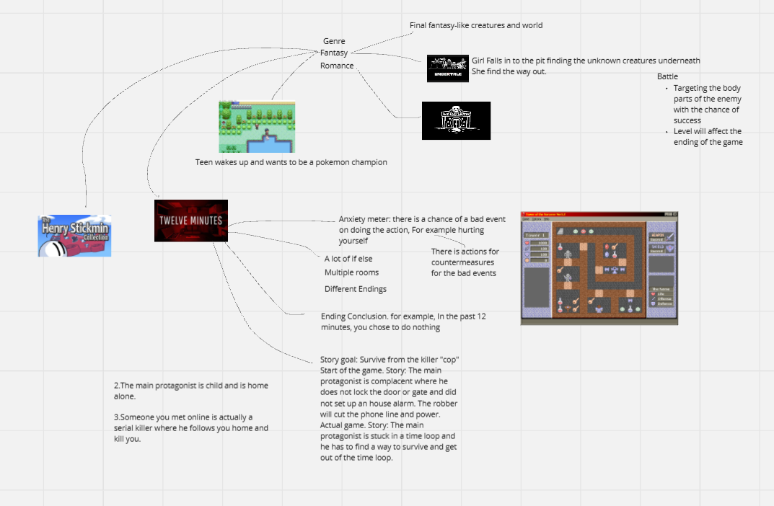

Slide 6

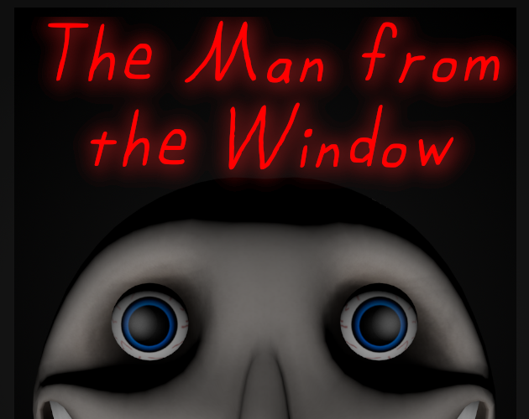

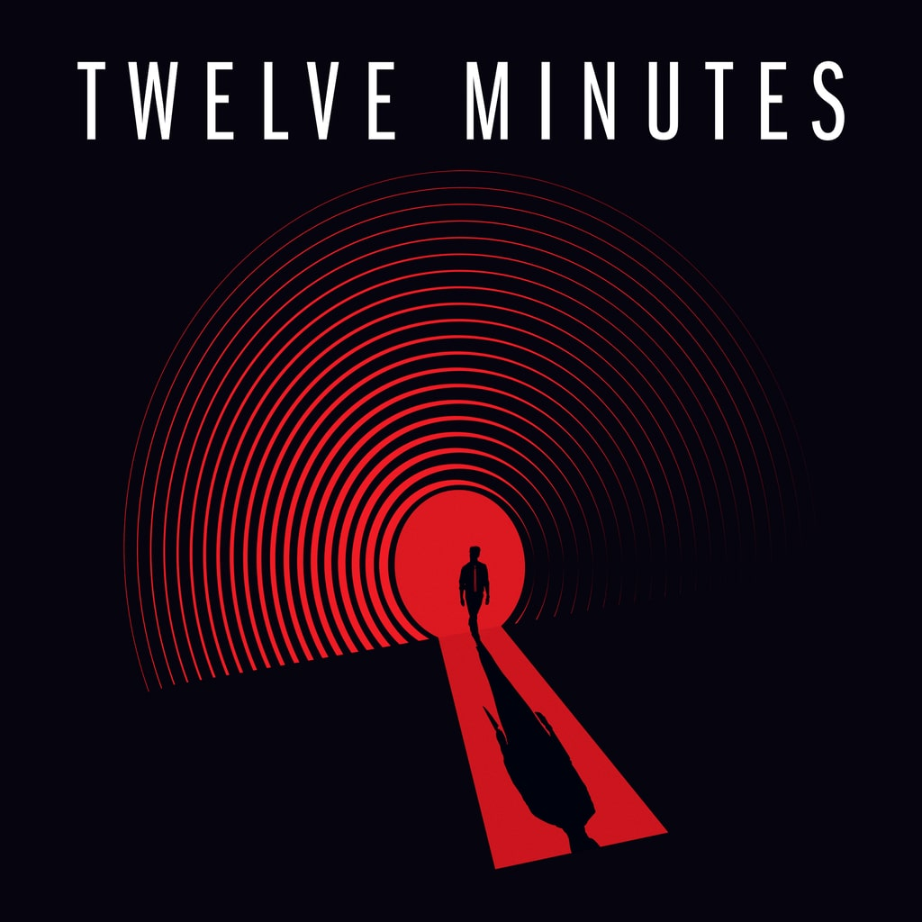
What’s inspired us?
BRAINSTORM
Game Concept
Story Concept

Slide 7
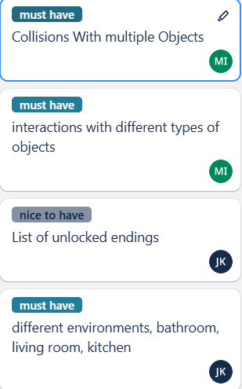
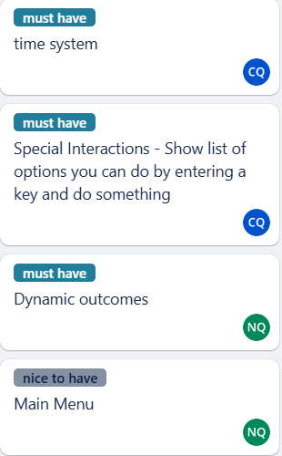
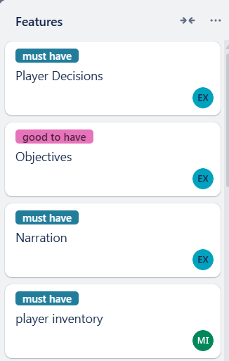
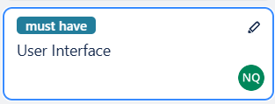
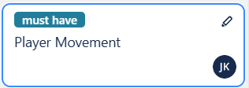
Features:

Slide 8
Individual Task list
Hazwan

Slide 9
Hazwan
Primary tasks:
Interactions with different type of objects.
Scene class to handle the all the objects in the scene and be able to load to a different scenes.
Secondary tasks:
Other things that I have done:
The images to print out when interacting
Player Inventory
class to handle all the objects by drawing the objects and collisions
Showing the nearby interactions you can do
Furniture class to store the type of furniture
GameObject class
GameManager class to control the gameflow and handle the systems
Furniture class

Slide 10
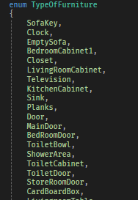
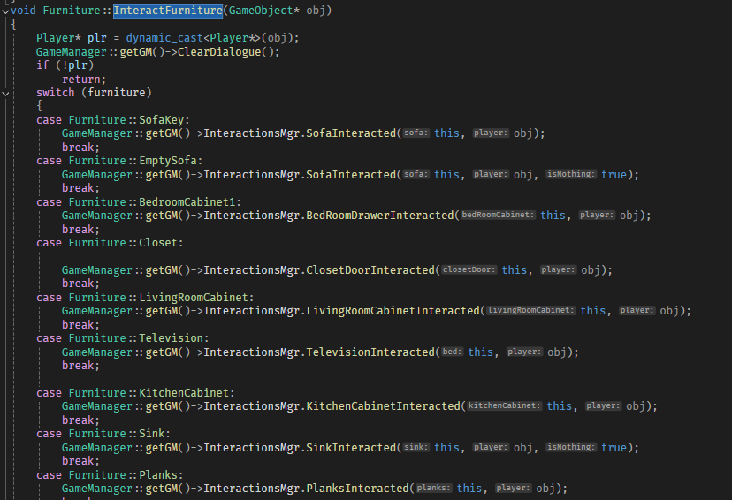
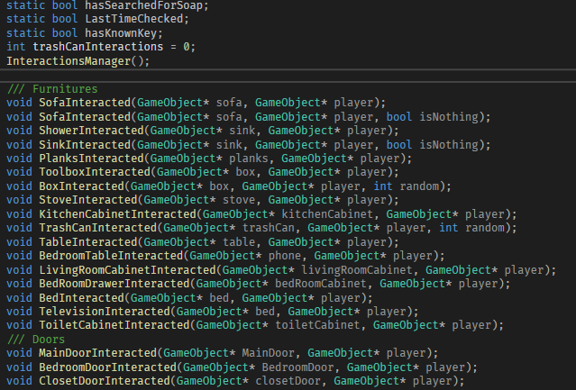
How did I do it?
Interactions with different objects:
Made the Furniture class which is a child of GameObject and the Furniture class has an 'enum' to differentiate the different objects in the world.
A
Then I made a Interactions Manager class, that handles the interactions of many different objects which is called from the furniture.

Slide 11
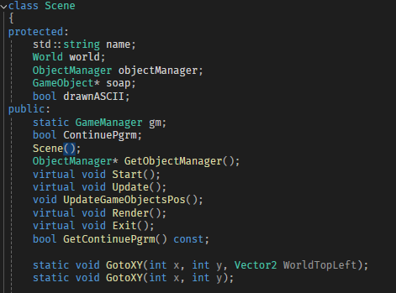
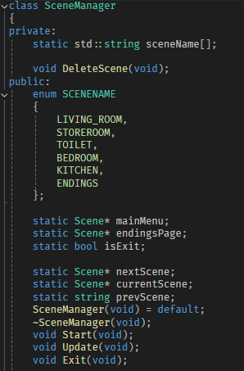
How did I do it?
Scene class to handle the all the objects in the scene and be able to load to a different scenes:
Made the class called Scene which is used as a base class to make the different rooms in the game.
Also I made a SceneManager class, that handles the updating the objects in the scene and able to transition between rooms

Slide 12
Individual Task list
Minh Quan

Slide 13
Minh Quan - Features
Primary tasks:
Dynamic Outcomes
User Interface
Secondary tasks
Other things that I have done:
Designed the UI for the game
Made the Main menu for the game
Made UI class to be used for dialogues and printing text on screen
Implemented the dialogue effect when narrating or interacting
Displaying Boxes for inventory and objectives
Text to tell which room the player is in
When the player is out of time then it will transition to the ending scene

Slide 14
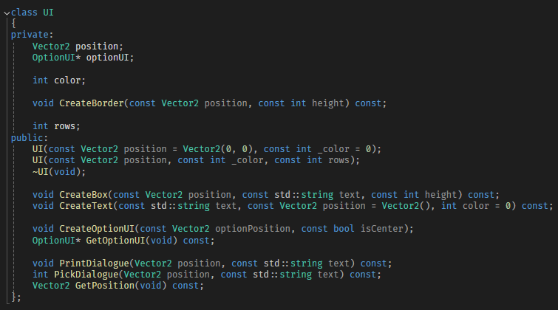
How did I do it?
User Interface:
UI class is made to handle UI related such as printing dialogues , create text with different, create text box and create option for player to pick. OptionUI will be responsible for storing options dynamically and clearing options after player have picked

Slide 15
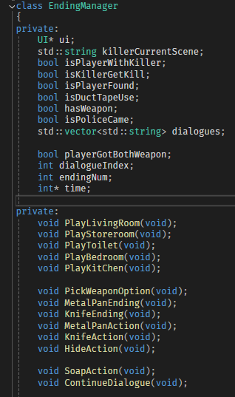
How did I do it?
Dynamic Outcomes:
The killer will follow through a chronological order by entering into 5 different room.
So:
For loop 5 times (each time different room)
- a switch case will be suitable to assign killer into different room function
Tracking and detecting if play and killer in same
If it is, handle in accordingly based on player's objects collected and their decision
Different combinations between object collection and
player's decision to form a new outcome.

Slide 16
Individual Task list
Cherry

Slide 17
Cherry
Time system to cue in killer and cops through interaction with objects
Options "enter or exit doors, interact with objects, use, help and menu"

Slide 18
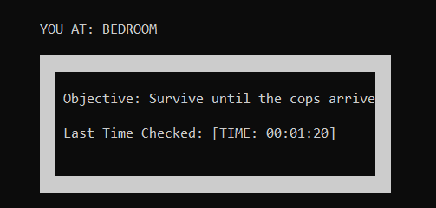
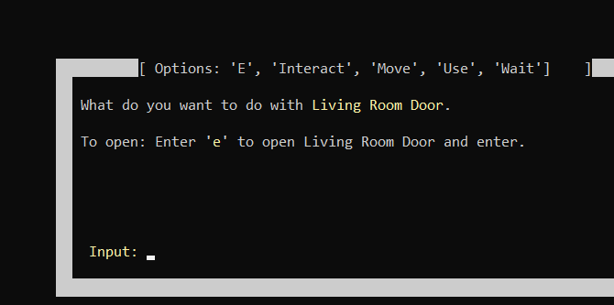
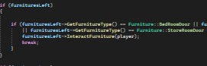
How did I do it:
By creating a class to handle the time system which adds to a "timer", when "timer" reaches 5 minutes, sys will cue killer to come in.
Options "enter or exit doors, interact with objects, use, and help"
To load scenes when interacting with doors, to trigger the interactions and usage with objects,

Slide 19
Individual Task list
Junhao

Slide 20
Junhao
Player Movement: This enable the player able to move around and explore the map.
Map: Different environments including Bedroom, Livingroom, Store room, Kitchen, Bathroom and most of the furnitures inside the scenes.
Endings: The pictures of the different endings and the function which can check does the player unlock the ending to show.

Slide 21
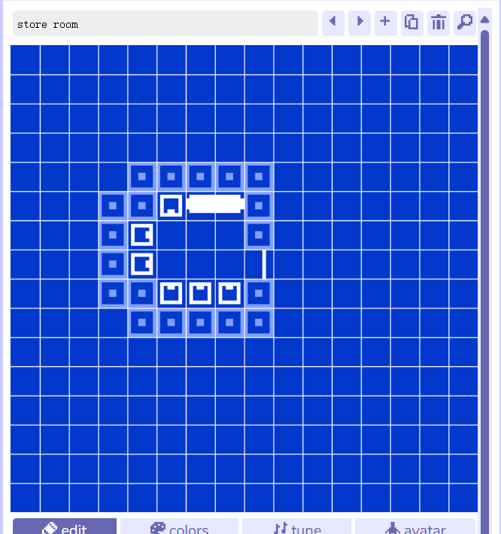
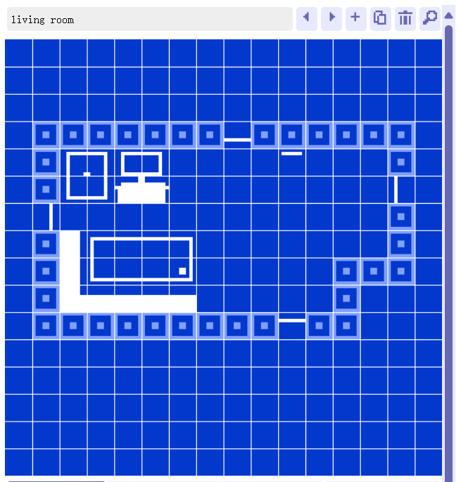
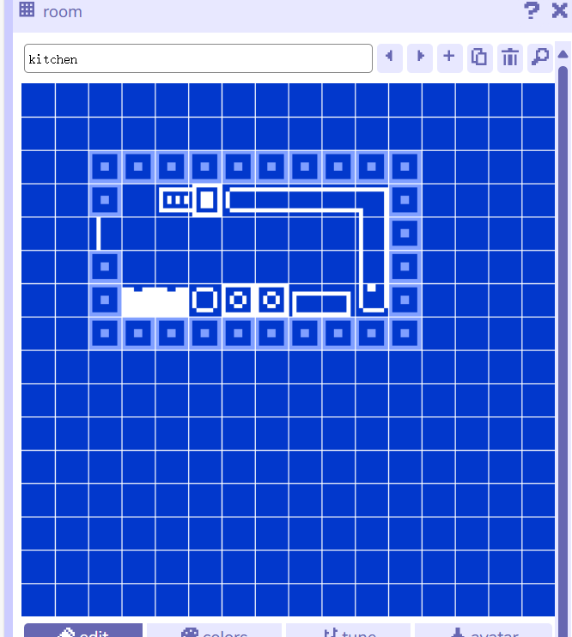
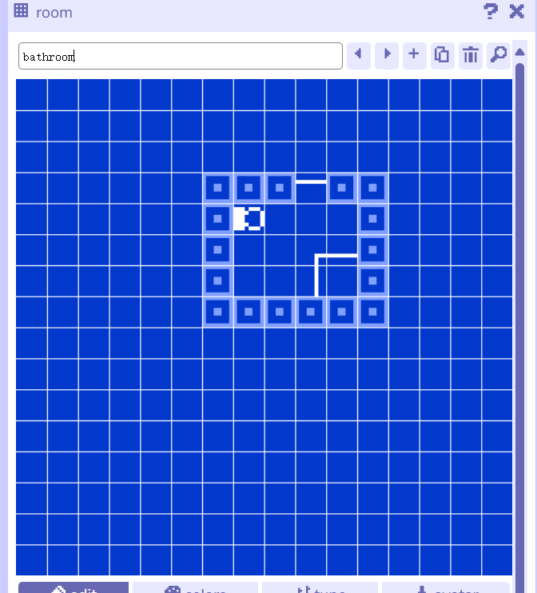
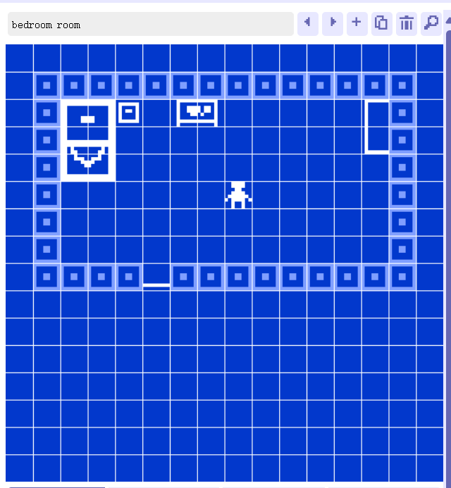

Slide 22
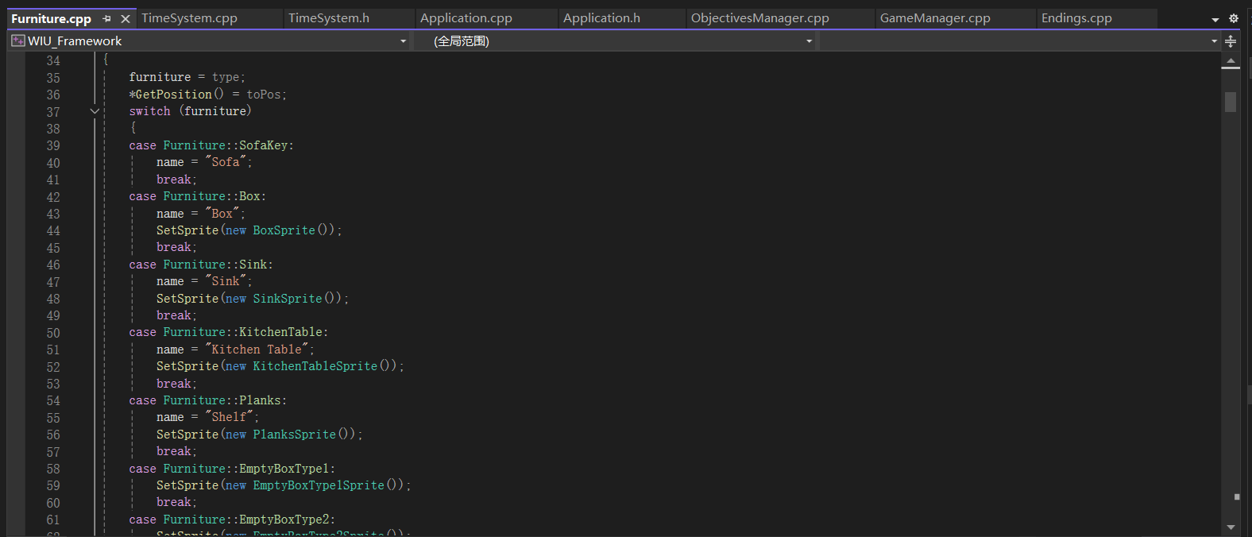
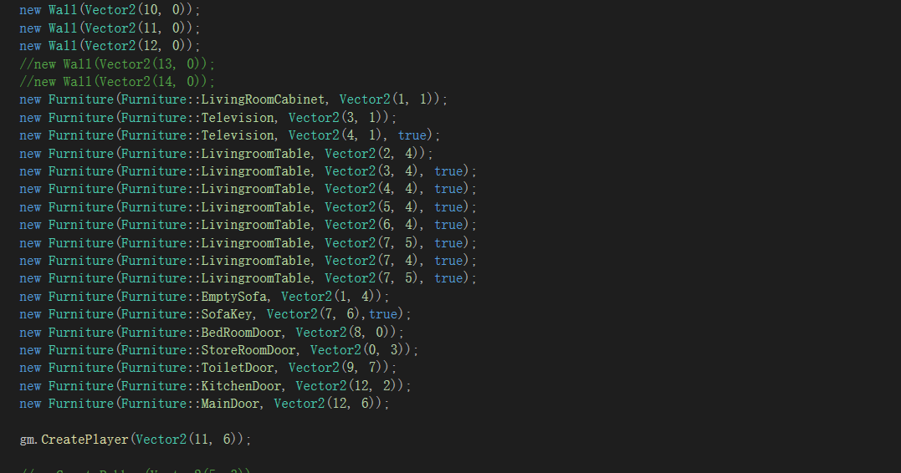
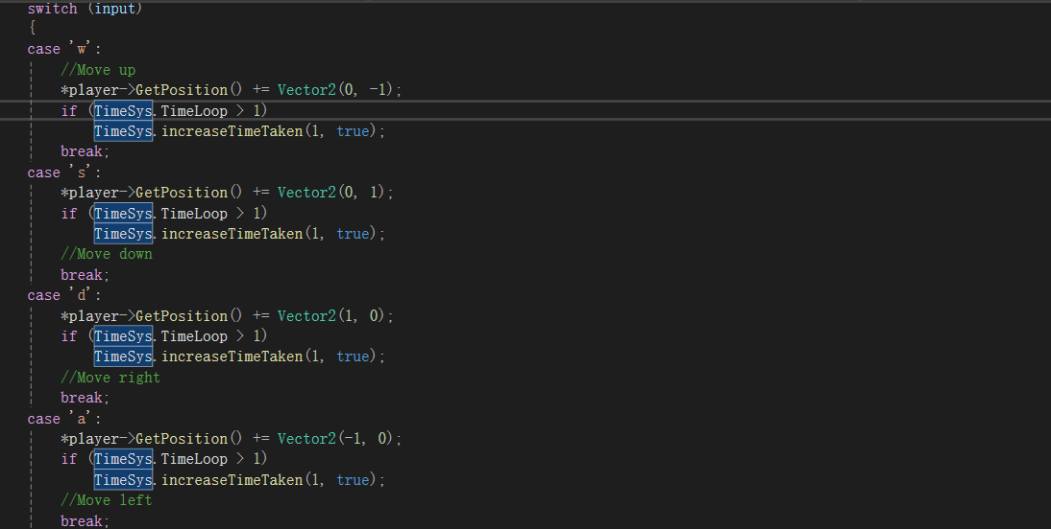
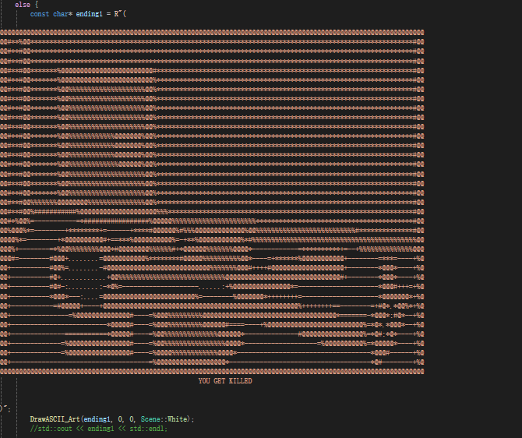
How did I do it?
For the map, I create pointers for the funitures and put it into the respective scene.
wddwa
For the player movement, I used vector 2 to store the value of x and y to make the player move.
For the ending scenes, I used const char* ending1 = R"(); to draw out the picture and DrawASCII_Art(ending1, 0, 0, Scene::White); to adjust the position and also bool isunlocked to check if the player unlocked the ending yet.

Slide 23
Individual Task list
Eric

Slide 24
Eric
Primary tasks:
Player decisions
Narration of the game
Other things that I have done:
Increasing time when interacting with objects
Displaying objectives
Script for the game (Story)

Slide 25
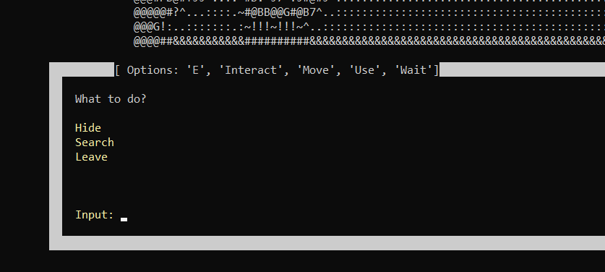
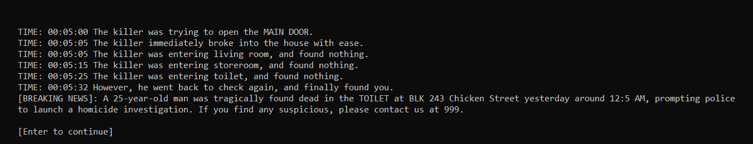
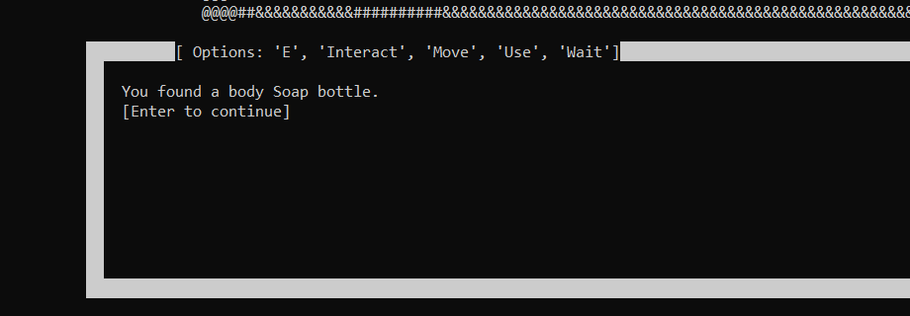
Player Decisions – After interacting, player can make different decisions leading to different outcome

Slide 26
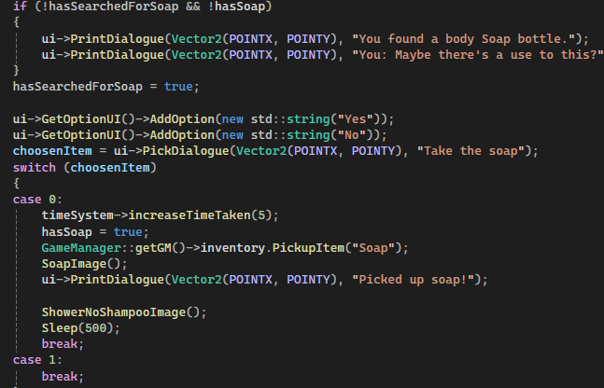
How did I do it?

Slide 27
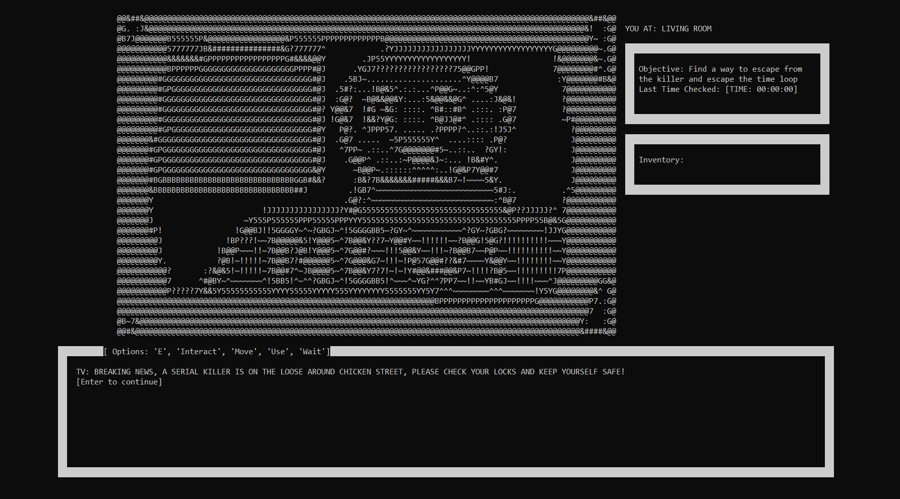

Narration – Dialogues of the game

Slide 28
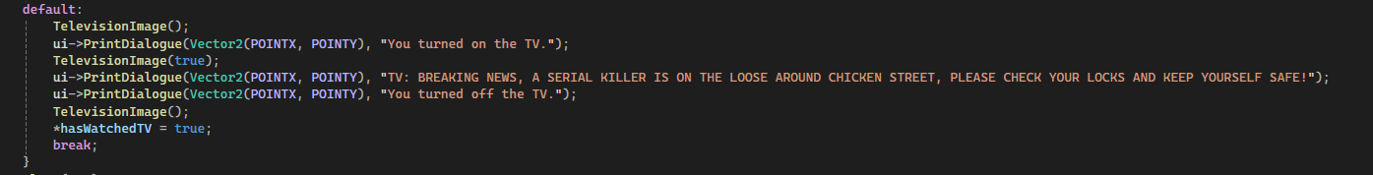
How did I do it?

Slide 29
Problems encountered?
Numerous Bugs
Communication
Changing of ideas midway of development

Slide 30
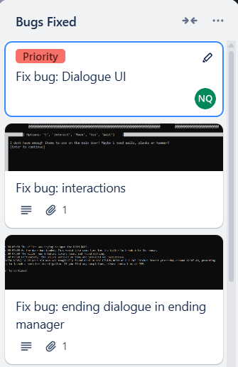
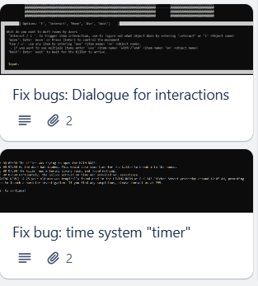
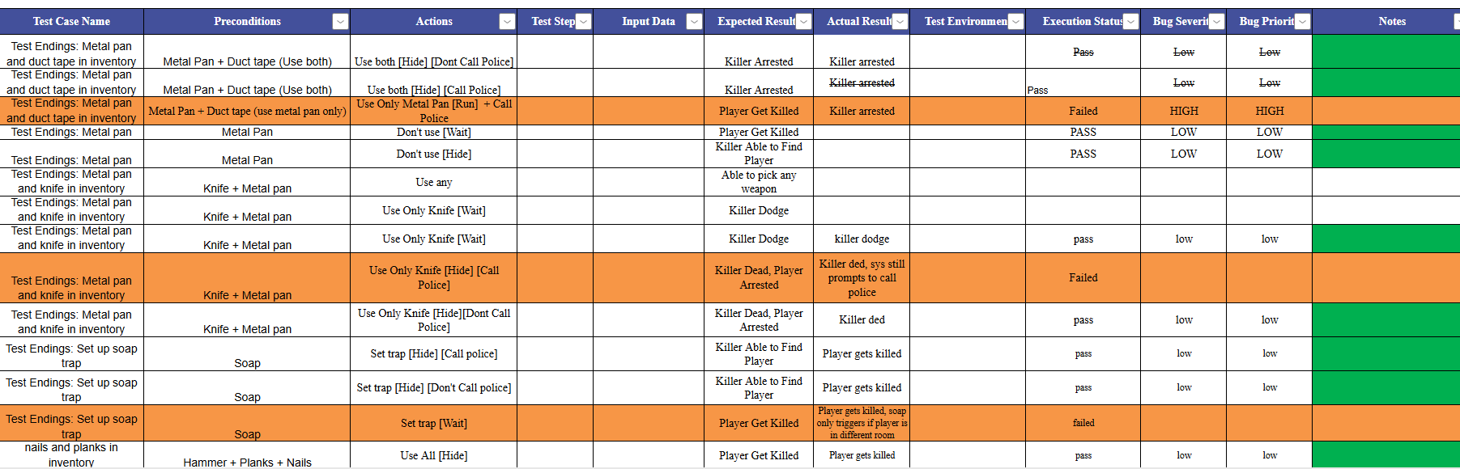
How we overcome?
Numerous Bugs:
We fixed them one by one and test for more bugs.
Communication:
We use multiple platforms (eg. Trello and Twine and discord) to convey the idea to one another and keep track of our progress.
Changing of ideas midway of development:
We avoided unnecessary changes and implemented the ones which are important.

Slide 31
Future enhancements
Larger map with more rooms to explore
More endings
More interactions
Allow player to save the game progress before exiting

